Slide 1

DISSERTATION
DISSERTATION
Enabling Continuous Improvement in Machine Learning Workflows through Data Logging and Monitoring MSc. In Artificial Intelligence
Dublin Business School
Swaraj Shaw| 10592394@mydbs.ie
Supervisor - Dr. Assem Abdelhak

Slide 2

Hello, I am Swaraj
Machine Learning Engineer
I have 3+ years of experience in the field of AI/ML and BI Analytics. My skills include data manipulation, data visualization, machine learning and statistical modelling, and natural language processing. I have a strong analytical and problem-solving approach and am skilled in delivering solutions to clients and businesses. I have also mentored and managed teams and have experience in requirement gathering, proposal writing, and project launches. In addition, I have expertise in cloud technologies and have completed projects involving Amazon Web Services, Google Cloud Platform, and Microsoft Azure.

Slide 3
Table Of Content
01
Introduction
04
Results & Deployment
Problem statement and brief about the solution and expectation of thesis.
Monitoring & Comparison of Metrics logged for MLOps success.
02
Background & Motivation
05
Limitation & Future Work
Previous work and Inspiration for the proposed research.
R&D of end-to-end ML Lifecycle and scalability of solution.
03
Methodology
06
Conclusion
Systematic Implementation of the solution
Effective MLOps and Enterprise Integration

Slide 4

Introduction Data Logging & Monitoring
Preface
Detecting and Mitigating model degradation using data logging and monitoring solution in machine learning workflows.

Slide 5

Effective MLOps
Problem Statement
Overview
01
Effective Data Logging & Monitoring
MLOps practices necessary for successful deployment and management of complex machine learning models in production environments
Data logging and monitoring crucial for effective MLOps
Comprehensive solution using open-source tools like MLFlow and WhyLogs presented
Solution designed for seamless integration into enterprise systems
Solution addresses issues like model drift to maintain accuracy and reliability of machine learning models over time
02
Solution Integration with Enterprise Environment
03
Comparative Study and Impact
Notes:
As companies continue to adopt and utilize advanced machine learning technologies, the need for effective MLOps practices becomes increasingly important to ensure the successful deployment and management of these complex models in production environments. In this research, we delve into the crucial role of data logging and monitoring in MLOps and present a comprehensive solution using open-source tools like MLFlow and WhyLogs. This solution is designed to be seamlessly integrated into enterprise systems and address issues such as model drift to maintain the accuracy and reliability of machine learning models over time.

Slide 6
Action Plan
Activities | Oct – 1st Half | Oct – 2nd Half | Nov – 1st Half | Nov – 2nd Half | Dec – 1st Half | Dec – 2nd Half
Meeting with Prof. + Project Scope Estimation
Dataset Selection
BERT Model using PyTorch
Integrating MLFLow with Model and perform data Logging + Data Profiling [WhyLogs]
Setup & Configure Azure VM
Deploy Container on Docker
Deploy all solution on cloud and draw model comparison
Research & Literature Review
Dataset Prep & Modelling
Deployment & Evaluation

Slide 7
Phases
Project Lifecycle
Concept Phase
Definition Phase
Organising Phase
Implementation Phase
Termination
Phase
Resources
Time

Slide 8

Background & Motivation
Motivation
Professional Experience
Personal experience working in machine learning team highlighted challenges of tracking and monitoring various metrics.
Many companies lack proper maintenance and logging processes leading to model degradation and drift over time.
Motivated to explore solution that helps data scientists monitor performance and improve models based on logged metrics.
Manager recognized value of such solution and encouraged pursuit of project.
Professor helped to scope down project goals and ensure they were achievable within the given time frame.
01
02
03
04
Literature Review
05

Slide 9
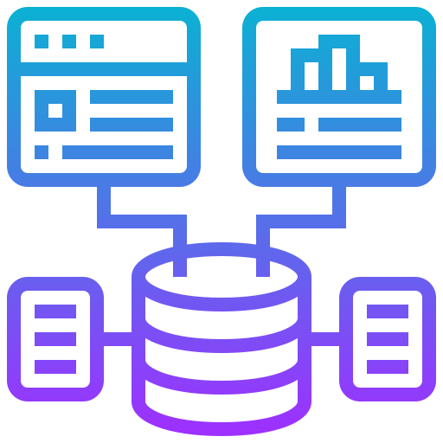
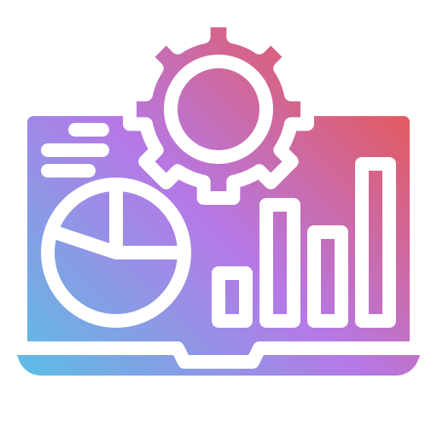
Literature Review
Key Insights
Paper Review + OpenSource Tools
01
ML model deployment challenges and importance of MLOps in production environments.
02
Data logging and monitoring are crucial for managing and improving ML models.
01 Model Performance Comparison
02 Scalability using Cloud Infra
03
MLFlow and WhyLogs for ML lifecycle and data monitoring
04
Considerations for building and deploying ML models in enterprise environments: scalability, reproducibility, and governance.
05
Production-ready ML involves model selection, deployment strategy, and maintenance.
06
Model drift occurs when training and inference data distributions differ.
03 Data Logging
04 Drift Monitoring & Alerts
Notes:
Machine Learning (ML) has significant challenges when it comes to deploying models in production environments, and effective MLOps (machine learning operations) practices are needed to manage the end-to-end lifecycle of ML models.
Data logging and monitoring are crucial for MLOps, as they allow organizations to track and optimize the performance of their ML models over time.
MLFlow and WhyLogs are open-source platforms for managing the end-to-end ML lifecycle and data monitoring and debugging, respectively.
Building and deploying ML models in enterprise environments requires considerations of scalability, reproducibility, and governance.
Production-ready ML involves choosing the appropriate model for a task, deciding on deployment strategies, and tracking and maintaining model performance.
Microsoft Azure Machine Learning is a cloud-based platform with tools and services for building, deploying, and managing ML models at scale.
Docker is a tool for packaging and deploying applications, and it can be used to deploy ML models in a production environment.
Model drift can occur when the distribution of data used for training differs from the distribution of data used for inference, and it can impact the performance of ML models.
A comprehensive solution for data logging, monitoring, and model drift management in MLOps is presented, using open-source tools such as MLFlow and WhyLogs, and designed to be easily integrated into existing enterprise environments like Microsoft Azure with Docker containers.

Slide 10

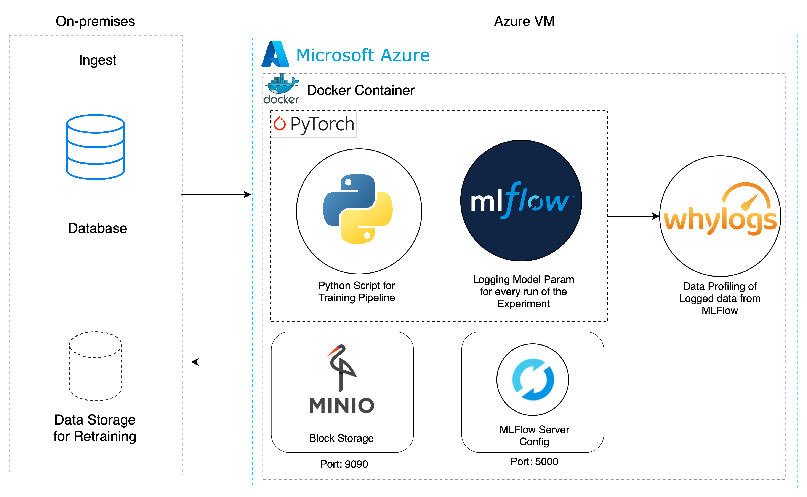
Pipeline Strategy
Methodology
Architecture
Data logging and monitoring system outlined in pipeline execution architecture
Custom dataset ingested from on-premises database, used to train BERT model for news classification.
MLFlow configured to track and store logged metrics and parameters of model run
Logged data subjected to data profiling with WhyLogs to track model drift and generate alerts
Solution containerized in Docker and deployed on Microsoft Azure VM for scalability and flexibility
Notes:
The described system utilizes an architecture that outlines the pipeline execution of the data logging and monitoring process. The solution begins with the ingestion of a custom dataset from an on-premises database, which is then used to train a BERT model. Concurrently, MLFlow is configured to track and store the logged metrics and parameters associated with the model run within a Min.io block storage system. This logged data is then subjected to data profiling, utilizing WhyLogs - an open-source data profiling and monitoring platform - to track model drift and generate statistical alerts. The entire solution is containerized within Docker and deployed on a Microsoft Azure virtual machine for optimal scalability and flexibility.

Slide 11
Results & Findings
Evaluation – Data Logging
I
nsights
The runs with higher average test accuracy (e.g., run 10 and run 9) may be more effective models for achieving the desired outcome.
The number of epochs, learning rate, and batch size can impact the model's performance (e.g., runs 4 and 5 had lower test accuracy despite using the same learning rate and number of samples as runs 2 and 3).
Some runs may have failed or not reached completion, which could be due to a variety of factors such as insufficient resources or suboptimal hyperparameter choices. It may be beneficial to analyze the causes of these failures and determine any corrective actions.
Optimizer choice (e.g., AdamW) can also affect the model's performance.
The duration of the training process should be taken into consideration, as longer training times may not always result in improved model performance.
Monitoring the training and validation loss can provide insight into the model's fit and generalization to new data.
Growth
Data
No. of Samples
20,000
42.17% Growth Increase on Test Acc wrt. Final Run
Maximum No. of Samples used
Model Runs
Model Comparison

Slide 12
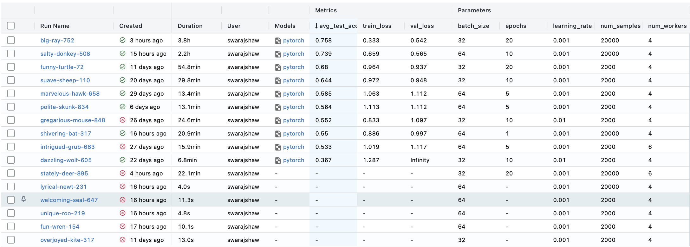
Results & Findings
Evaluation – Data Logging
MLFlow Runs

Slide 13
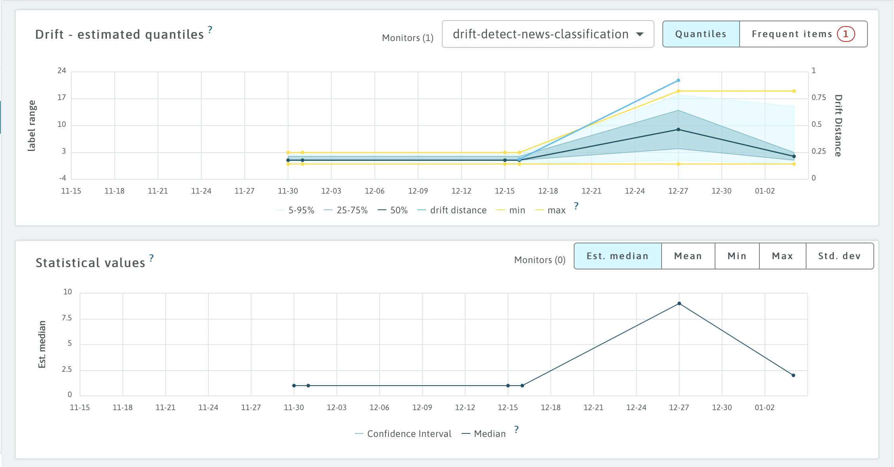
Results & Findings
Evaluation – Data Profiling
Drift Detection on Logged Data
Data is divided into smaller chunks (streams) and processed in batches to allow for more frequent updates to the model
Function generates summary of profiling data for dataset, including statistical measures and plots/charts
Drift report function generates report on magnitude and direction of drift in dataset, including statistical measures and plots/charts
Drift detected in "label" feature, but not "description" feature
Data logging and monitoring helps improve pipeline by allowing for real-time tracking and troubleshooting of issues
Can detect drift in dataset and take appropriate measures to address it
Model performance can be impacted by drift, so it is important to monitor and address it.

Slide 14
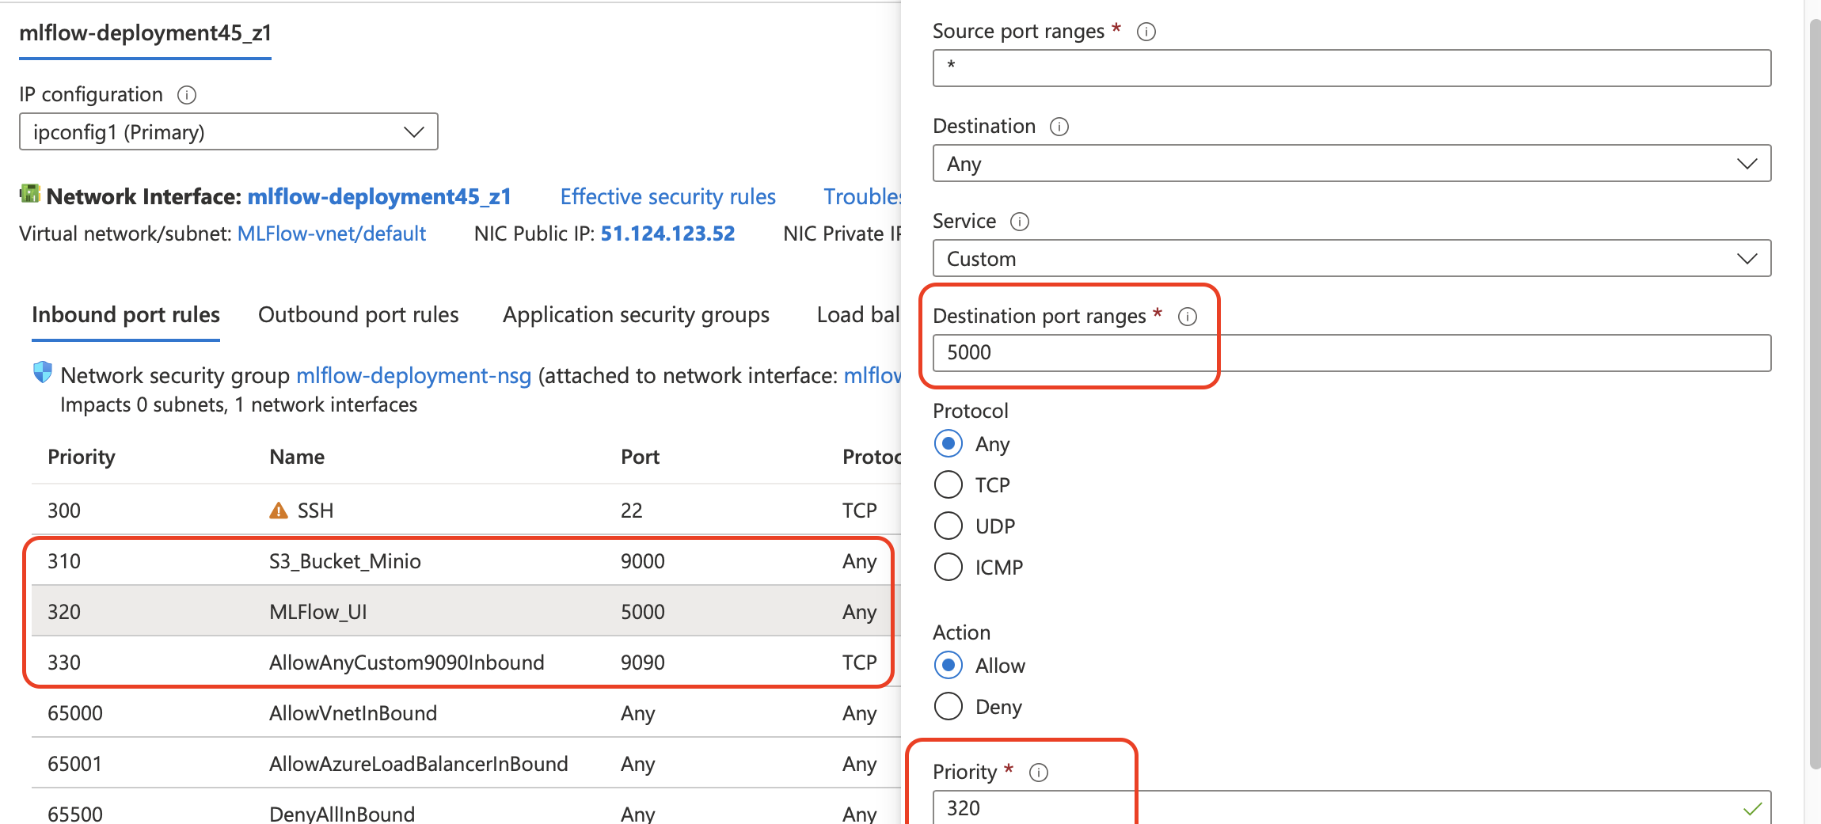
Cloud Deployment
Deployment
Docker | Azure | Min.io
Steps to create Ubuntu Server VM in Azure
Configuration options for VM, including administrator username and password, protocol and port range for rules
Install Docker Engine and Docker Compose on Ubuntu VM
Clone repository and fetch codebase
Modify .env file with environment variables for bucket.py script and docker-compose.yml file
Use docker-compose to build and start containers for MLFlow, Minio, and MySQL
Test and use MLFlow UI, Minio, and MySQL by visiting specified URLs

Slide 15
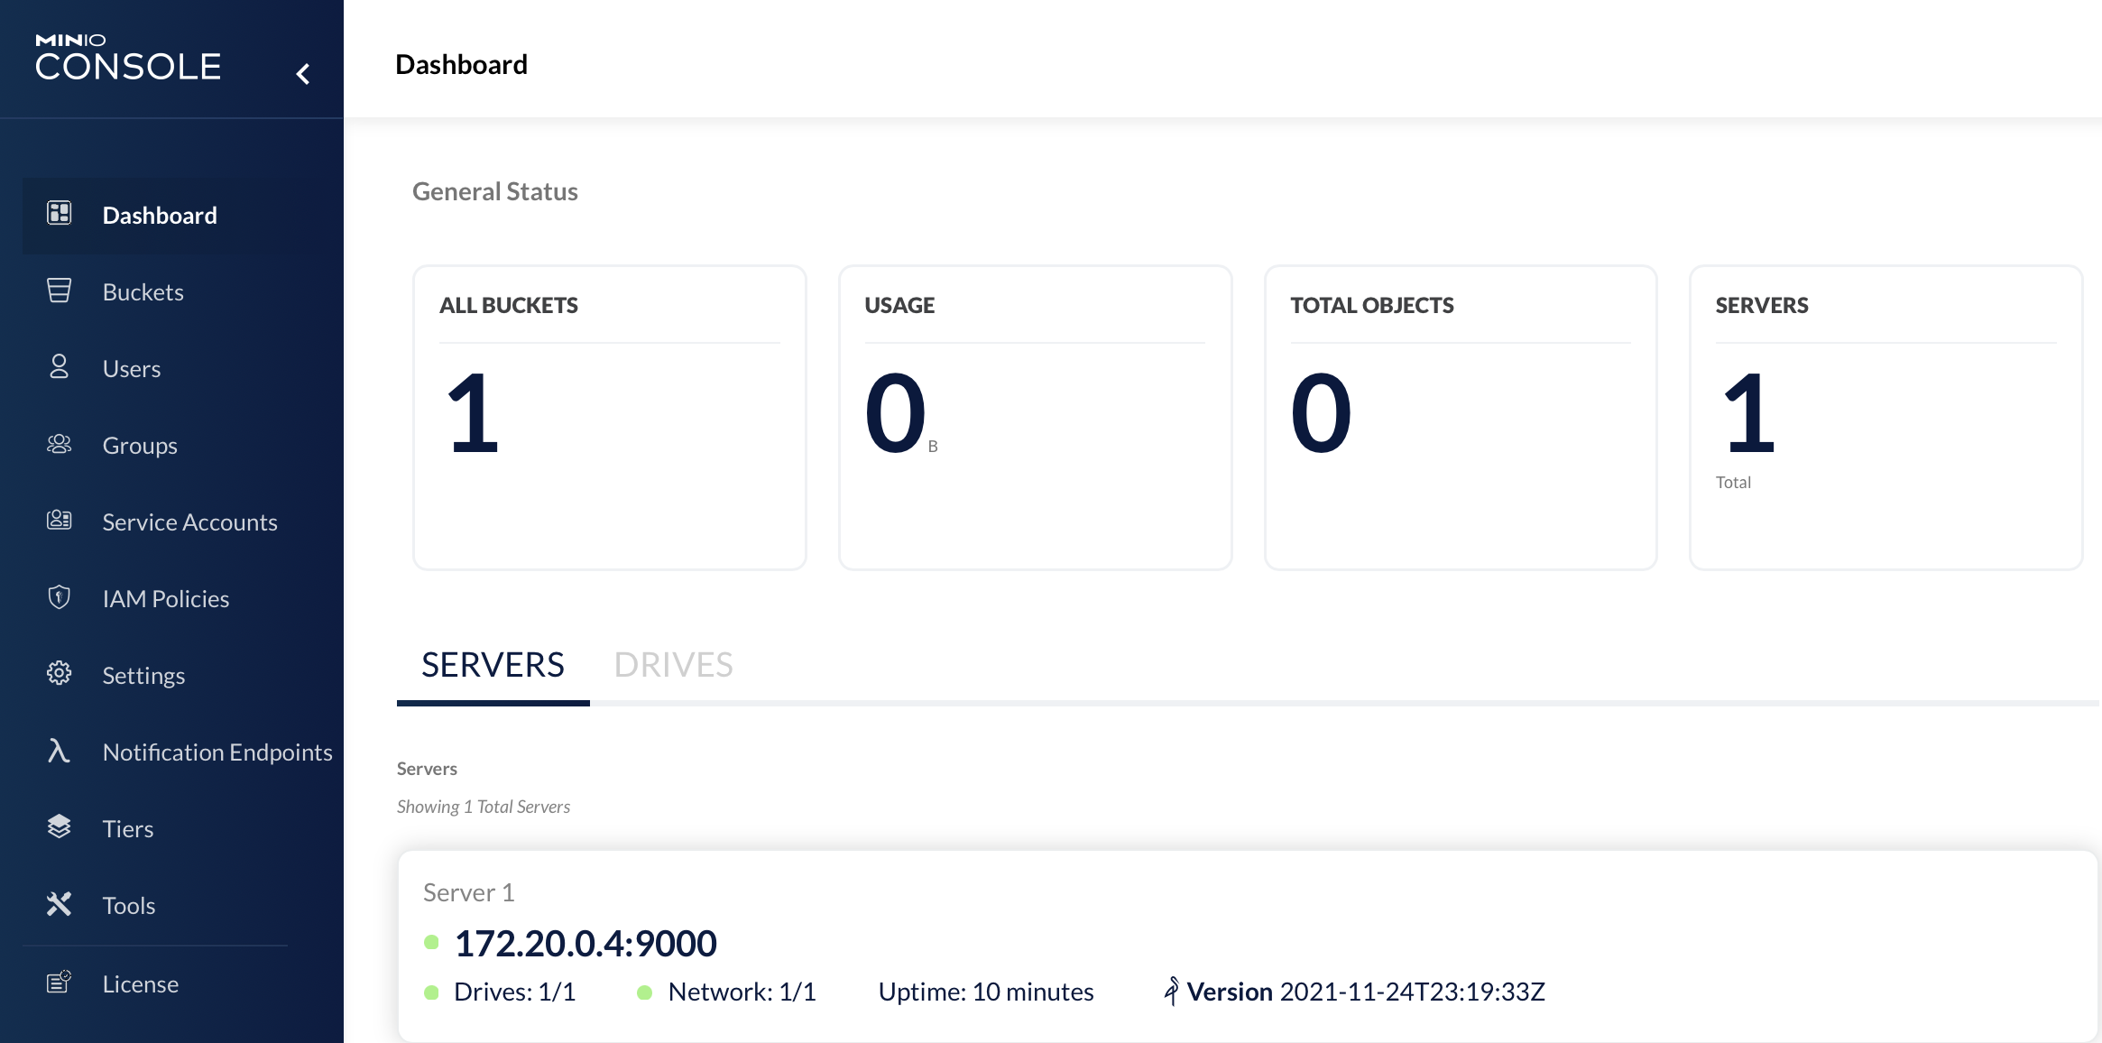
Min.io
Deployment
Minio is a cloud-based object storage service that is used to store and retrieve data
Deployment of Minio on Azure VM involves installing Docker Engine and Docker Compose, then using docker-compose to build and start the Minio container
Environment variables, such as MINIO_ROOT_USER and MINIO_ROOT_PASSWORD, can be specified in the .env file and used in the bucket.py script and docker-compose.yml file
Minio can be accessed and used through its web UI by visiting the specified URL
Minio can be used as a storage backend for the MLFlow server, which is also deployed in a Docker container on the Azure VM.

Slide 16
Limitation & Future Work
Limitation
Some potential limitations of the data logging and monitoring solution presented in this project include.
01
02
03
04
Dependence on Open Source Tools
Integration with existing systems
Complexity and Maintenance
Cost
Notes:
Dependence on open-source tools: While the use of open-source tools such as MLFlow and WhyLogs can provide many benefits, it also means that the solution is dependent on the continued development and support of these tools. If the tools are no longer actively maintained or do not meet the needs of the organization, it may be necessary to switch to alternative solutions.
Integration with existing systems: Another potential limitation is the need to integrate the data logging and monitoring solution with existing systems and processes within the organization. This may require significant effort and resources, and may be challenging if the organization has legacy systems or processes that are difficult to modify.
Complexity: The solution may be complex to set up and maintain, particularly for organizations with limited experience with MLOps. This could be a barrier for organizations that do not have the necessary skills or resources to effectively implement and manage the solution.
Cost: While the use of open-source tools can help reduce costs, there may still be significant expenses associated with implementing and maintaining the data logging and monitoring solution. This could be a barrier for organizations with limited budgets or resources.

Slide 17
Future Work
Future Work
Data logging and monitoring is critical for effective MLOps
Open-source tools such as MLFlow and WhyLogs can help track and visualize metrics, detect and alert on anomalies, and provide insights into model performance
Model drift is a potential issue that must be addressed to ensure model accuracy and reliability
Utilizing the Toloka platform for data labelling and annotation tasks can help organizations efficiently prepare and curate data for machine learning operations.
01
02
Expanding Scope of the Solution
Exploring Model Drift
03
04
Testing on Real World Environment
Impact on Performance & Reliability

Slide 18



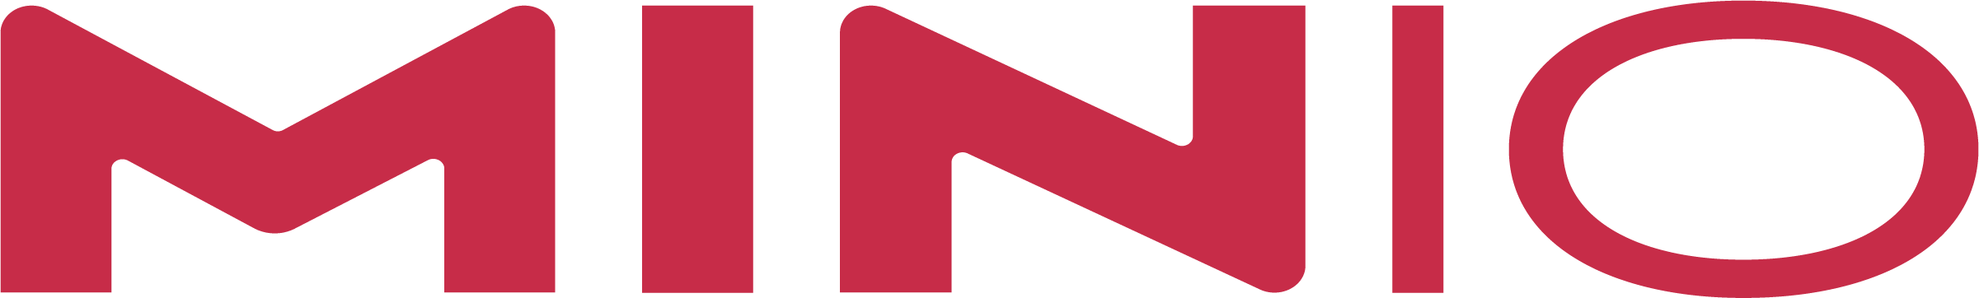
One Platform Runs Anywhere
Conclusion
The project demonstrated the importance of effective data logging and monitoring in MLOps
Open-source tools such as MLFlow and WhyLogs can significantly improve data logging and monitoring
Model drift is an important consideration and techniques for detecting and mitigating drift are necessary
There are potential areas for future work, including expanding the scope of the solution, exploring model drift, testing in real-world environments, and studying the impact on overall ML system performance
Utilizing the Toloka platform for data labelling and annotation tasks could be a valuable addition to the solution

Slide 19

Thank You
Thank You

